Slide 1
Constructor in Java
In Java, constructor is a block of codes similar to method. It is called when an instance of object is created and memory is allocated for the object.
It is a special type of method which is used to initialize the object.

Slide 2
When a constructor is called
Everytime an object is created using new() keyword, atleast one constructor is called. It is called a default constructor.
Note: It is called constructor because it constructs the values at the time of object creation. It is not necessary to write a constructor for a class. It is because java compiler creates a default constructor if your class doesn't have any.

Slide 3
Rules for creating java constructor
There are basically two rules defined for the constructor.
Constructor name must be same as its class name
Constructor must have no explicit return type

Slide 4
Java Default Constructor A constructor is called "Default Constructor" when it doesn't have any parameter. Example of default constructor
In this example, we are creating the no-arg constructor in the Bike class. It will be invoked at the time of object creation.
class Bike1{
Bike1() //constructor without parameter
{
System.out.println("Bike is created");}
public static void main(String args[]){
Bike1 b=new Bike1();
}
}
If there is no constructor in a class, compiler automatically creates a default constructor.

Slide 5
Example of default constructor that displays the default values
class Student3{
int id;
String name;
void display()
{
System.out.println(id+" "+name);}
public static void main(String args[]){
Student3 s1=new Student3();
Student3 s2=new Student3();
s1.display();
s2.display();
}
}
Explanation:In the above class,you are not creating any constructor so compiler provides you a default constructor.Here 0 and null values are provided by default constructor.

Slide 6
Java parameterized constructor A constructor which has a specific number of parameters is called parameterized constructor.
Parameterized constructor is used to provide different values to the distinct objects

Slide 7
Example of parameterized constructor
In this example, we have created the constructor of Student class that have two parameters. We can have any number of parameters in the constructor.

Slide 8
class Student4{
int id;
String name;
Student4(int i,String n){
id = i;
name = n;
}
void display(){System.out.println(id+" "+name);}
public static void main(String args[]){
Student4 s1 = new Student4(111,"Karan");
Student4 s2 = new Student4(222,"Aryan");
s1.display();
s2.display();
}
}

Slide 9
Constructor Overloading in Java
In Java, a constructor is just like a method but without return type. It can also be overloaded like Java methods.
Constructor overloading in Java is a technique of having more than one constructor with different parameter lists. They are arranged in a way that each constructor performs a different task. They are differentiated by the compiler by the number of parameters in the list and their types.

Slide 10
Example of Constructor Overloading
class Student5{
int id;
String name;
int age;
Student5(int i,String n){
id = i;
name = n;
}
Student5(int i,String n,int a){
id = i;
name = n;
age=a;
}
void display(){System.out.println(id+" "+name+" "+age);}
public static void main(String args[]){
Student5 s1 = new Student5(111,"Karan");
Student5 s2 = new Student5(222,"Aryan",25); Overloading Constructor
s1.display();
s2.display();
}
}

Slide 11
Difference between constructor and method in java
There are many differences between constructors and methods. They are given below.
Java Constructor | Java Method
Constructor is used to initialize the state of an object. | Method is used to expose behaviour of an object.
Constructor must not have return type. | Method must have return type.
Constructor is invoked implicitly. | Method is invoked explicitly.
The java compiler provides a default constructor if you don't have any constructor. | Method is not provided by compiler in any case.
Constructor name must be same as the class name. | Method name may or may not be same as class name.

Slide 12
Java Copy Constructor There is no copy constructor in java. But, we can copy the values of one object to another like copy constructor in C++.
There are many ways to copy the values of one object into another in java. They are:
By constructor
By assigning the values of one object into another
By clone() method of Object class

Slide 13
class Student6{
int id;
String name;
Student6(int i,String n){
id = i;
name = n;
}
Student6(Student6 s){
id = s.id;
name =s.name;
}
void display(){System.out.println(id+" "+name);}
public static void main(String args[]){
Student6 s1 = new Student6(111,"Karan");
Student6 s2 = new Student6(s1); //Copy construtor
s1.display();
s2.display();
}
}

Slide 14
Java static keyword
The static keyword in java is used for memory management mainly. We can apply java static keyword with variables, methods, blocks and nested class. The static keyword belongs to the class than instance of the class.
The static can be:
variable (also known as class variable)
method (also known as class method)
block
nested class

Slide 15
Java static variable
If you declare any variable as static, it is known static variable.
The static variable can be used to refer the common property of all objects (that is not unique for each object) e.g. company name of employees,college name of students etc.
The static variable gets memory only once in class area at the time of class loading.

Slide 16
Advantage of static variable It makes your program memory efficient (i.e it saves memory).
Understanding problem without static variable
class Student{
int rollno;
String name;
String college="ITS";
Suppose there are 500 students in my college, now all instance data members will get memory each time when object is created.All student have its unique rollno and name so instance data member is good.Here, college refers to the common property of all objects.If we make it static,this field will get memory only once.

Slide 17
Example of static variable
class Student8{
int rollno;
String name;
static String college ="ITS";
Student8(int r,String n){
rollno = r;
name = n;
}
void display (){System.out.println(rollno+" "+name+" "+college);}
public static void main(String args[]){
Student8 s1 = new Student8(111,"Karan");
Student8 s2 = new Student8(222,"Aryan");
s1.display();
s2.display();
}
}

Slide 18
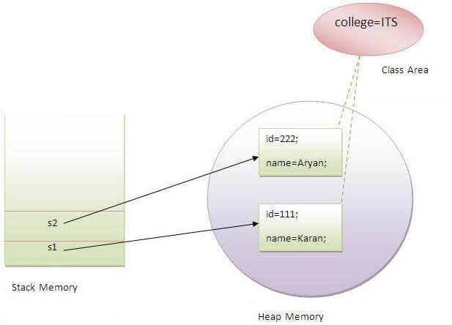

Slide 19
Program of counter without static variable
In this example, we have created an instance variable named count which is incremented in the constructor. Since instance variable gets the memory at the time of object creation, each object will have the copy of the instance variable, if it is incremented, it won't reflect to other objects. So each objects will have the value 1 in the count variable.

Slide 20
class Counter{
int count=0;//will get memory when instance is created
Counter(){
count++;
System.out.println(count);
}
public static void main(String args[]){
Counter c1=new Counter();
Counter c2=new Counter();
Counter c3=new Counter();
}
}
Output:1 1 1

Slide 21
Program of counter by static variable As we have mentioned above, static variable will get the memory only once, if any object changes the value of the static variable, it will retain its value.
class Counter2{
static int count=0;//will get memory only once and retain its value
Counter2(){
count++;
System.out.println(count);
}
public static void main(String args[]){
Counter2 c1=new Counter2();
Counter2 c2=new Counter2();
Counter2 c3=new Counter2();
}
}

Slide 22
Java static method
If you apply static keyword with any method, it is known as static method.
A static method belongs to the class rather than object of a class.
A static method can be invoked without the need for creating an instance of a class.
static method can access static data member and can change the value of it.

Slide 23
Example of static method
class Student9{
int rollno;
String name;
static String college = "ITS";
static void change(){
college = "BBDIT";
}
Student9(int r, String n){
rollno = r;
name = n;
}
void display (){System.out.println(rollno+" "+name+" "+college);}
public static void main(String args[]){
Student9.change();
Student9 s1 = new Student9 (111,"Karan");
Student9 s2 = new Student9 (222,"Aryan");
Student9 s3 = new Student9 (333,"Sonoo");
s1.display();
s2.display();
s3.display();
}

